Slide 1
Find Optimal Locations for Opening Up a Bubble Tea Shop in Toronto
Yuxin “Melanie” Cui

Slide 2
Bubble tea in toronto
Bubble tea
has become exceedingly popular in North America with a growing market.
has a stable customer source especially among Chinese
Toronto
most populous city in Canada
has large Asian population

Slide 3
Data acquisition and cleaning
List of neighborhoods of the city of Toronto from https://en.wikipedia.org/wiki/List_of_postal_codes_of_Canada:_M
Geographical coordinates of city of Toronto using Geopy library
Geographical coordinates of boroughs from http://cocl.us/Geospatial_data
Venue data related to the interested regions was retrieved by using Foursquare API.
Dropped rows with missing values in borough column

Slide 4
Data manipulation
258 unique categories of venues
Selected boroughs of East York, North York, Scarborough and Toronto for further examination
Calculated the mean on the frequency of occurrence of each venue category
Chose the keyword column “Chinese Restaurant”

Slide 5
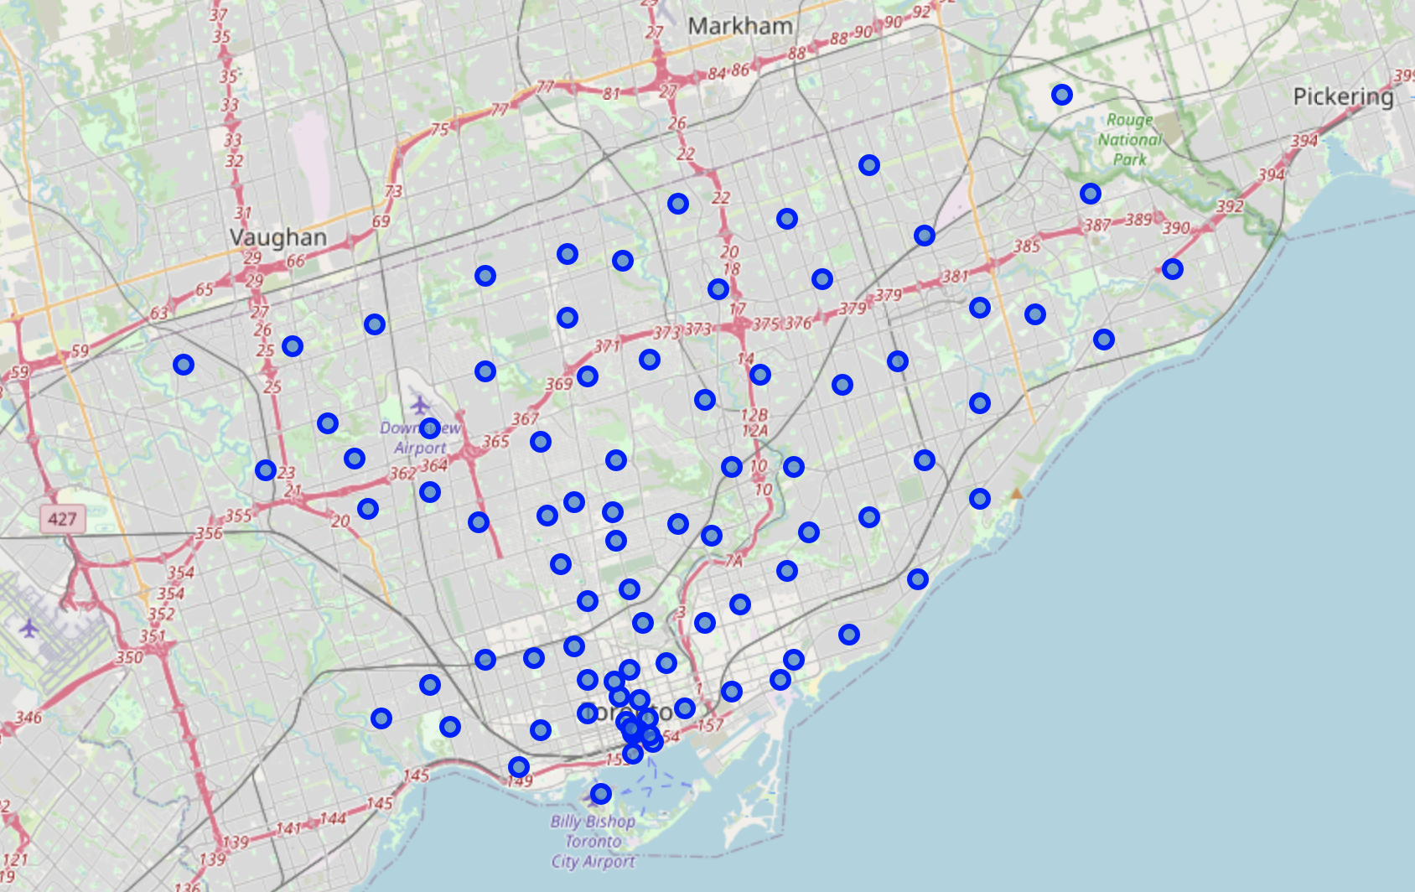
Selected Boroughs

Slide 6
K-means Clustering
K number of clusters = 3
Frequency of occurrence of the keyword column “Chinese Restaurant”
Results:
Label #
Cluster 0 | Neighborhoods with least Chinese restaurants
Cluster 1 | Neighborhoods with most Chinese restaurants
Cluster 2 | Neighborhoods with some Chinese restaurants

Slide 7
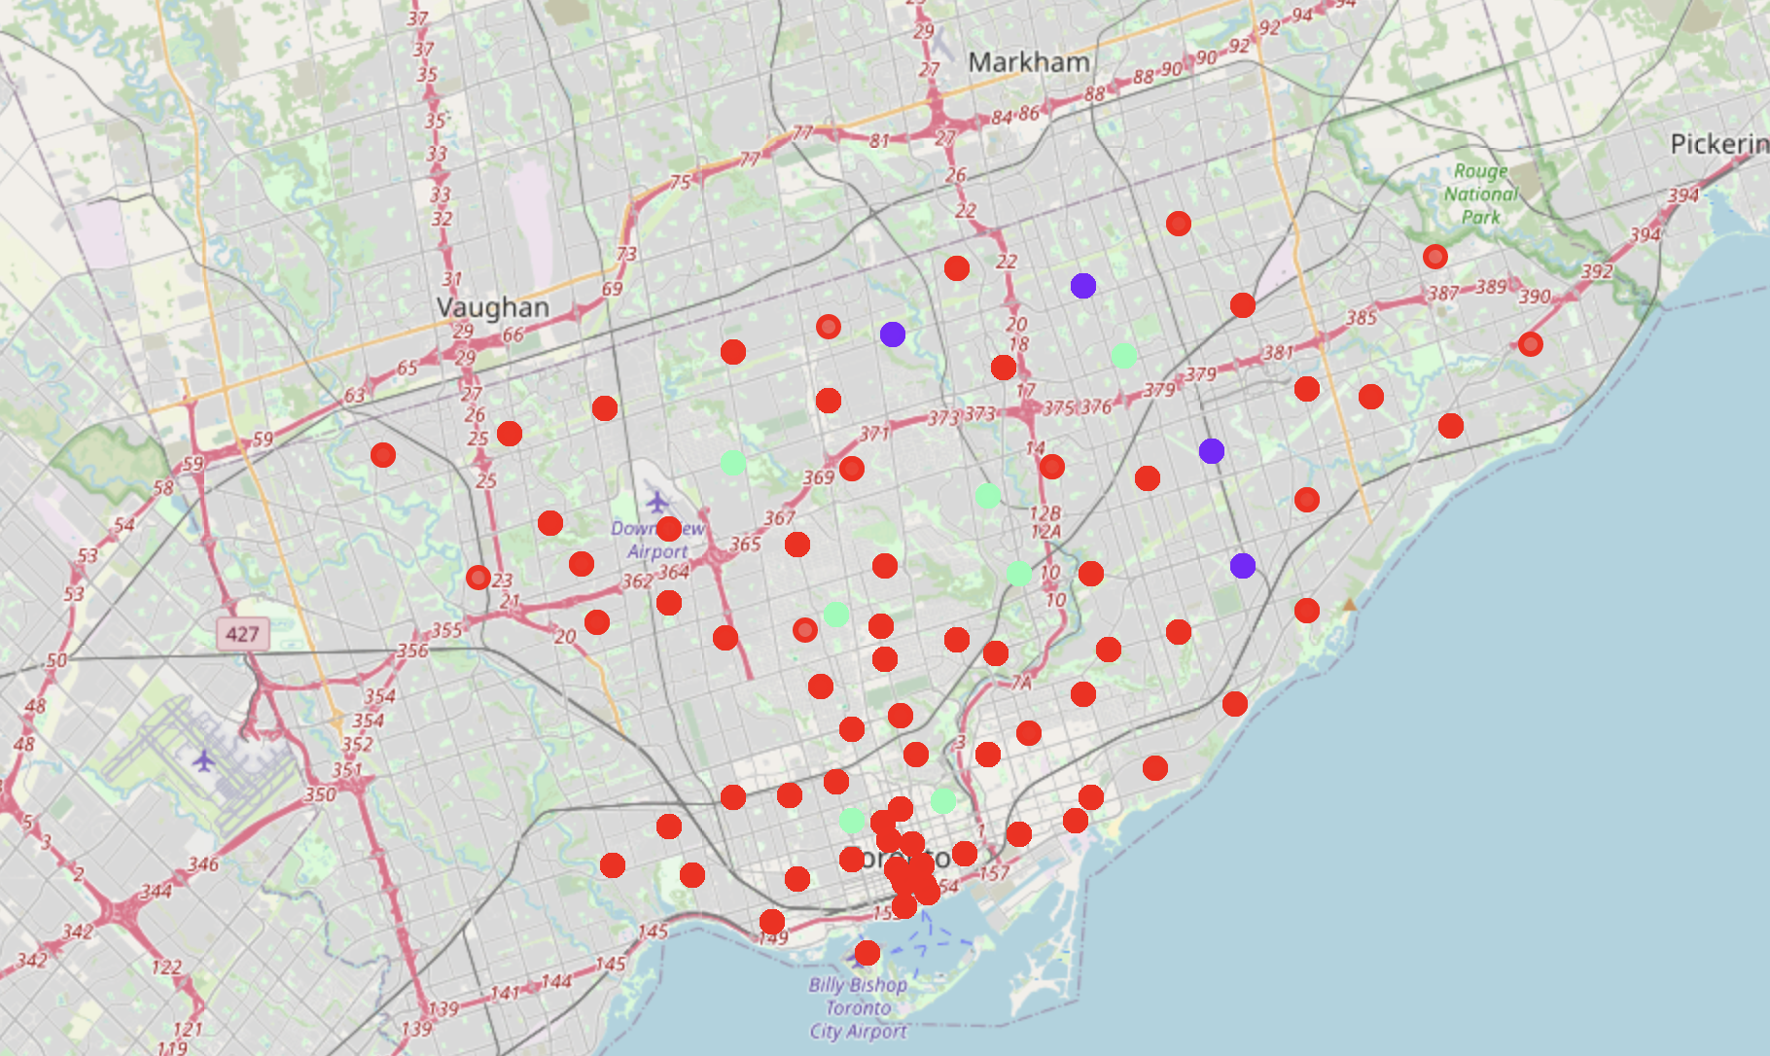
Cluster 0 : red
Cluster 1 : purple
Cluster 2 : green

Slide 8
recommendations
Recommended Steeles West and L'Amoreaux West in the borough of Scarborough
High frequency of occurrence of “Chinese Restaurant”
Less competitions from other bubble tea shops such as Church and Wellesley, Central Bay Street, Garden District and Ryerson in Downtown Toronto
Cluster 2

Slide 9
Conclusion and future directions
Other factors influences recommendations:
Existence of other Asian restaurants and coffee shops
Local population density
Average income
Choices of K can be further reasoned
K-means clustering useful for data grouping but should be paired with more keywords

